Slide 1



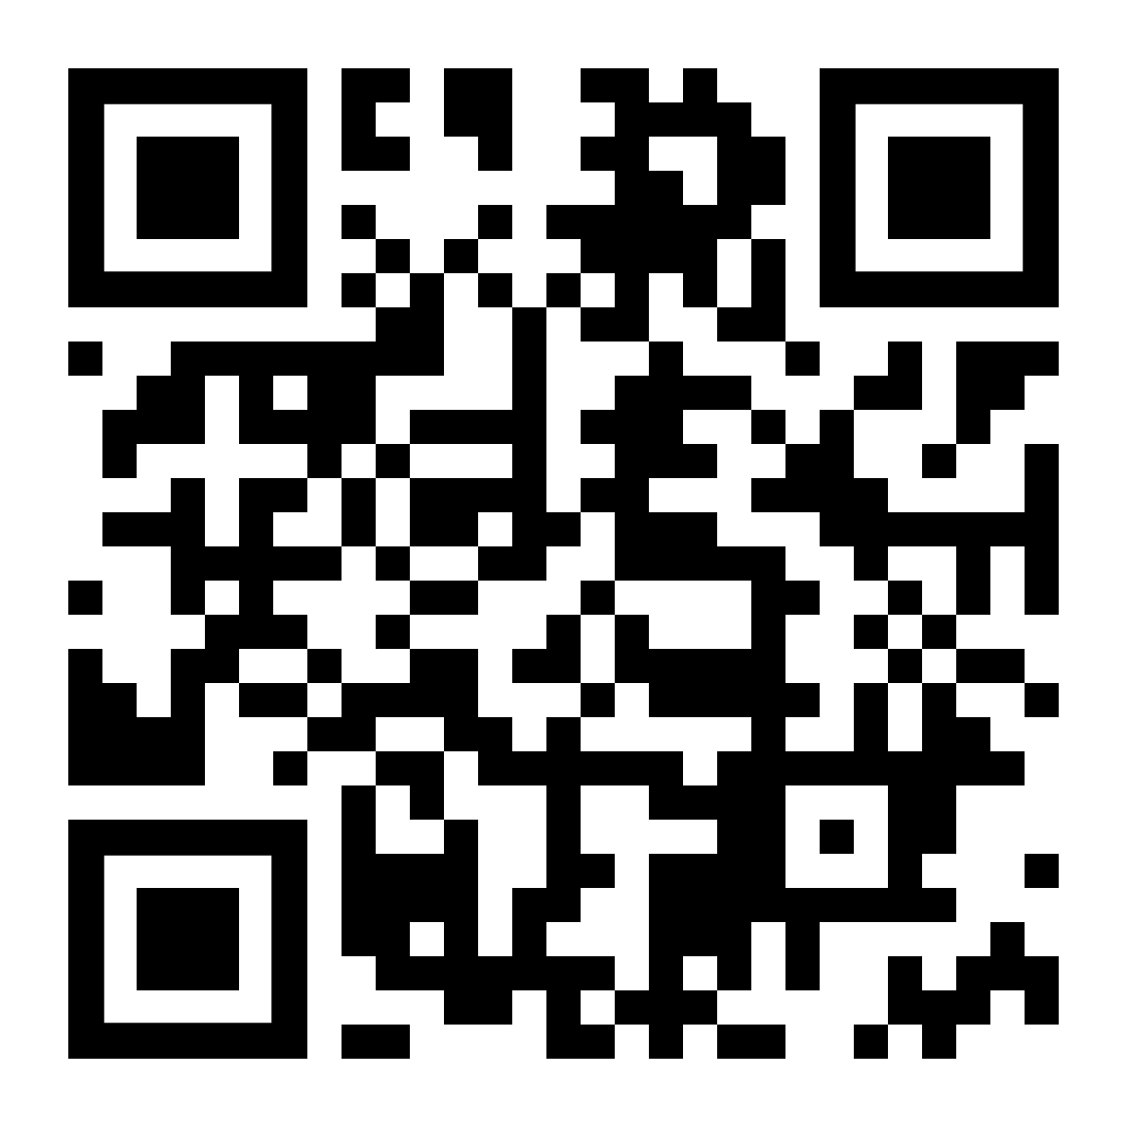



DEVELOPING MULTI-TENANT APPLICATIONS WITH .NET AND ABP FRAMEWORK
Follow me on X (Twitter)
Halil İbrahim KALKAN
Co-founder & Lead Architect at Volosoft
hibrahimkalkan
hikalkan

Slide 2

TITLE
.

Slide 3
TITLE
.

Slide 4
TITLE
.

Slide 5
TITLE
.

Slide 6
TITLE
.

Slide 7
TITLE
.

Slide 8
TITLE
.

Slide 9
TITLE
.

Slide 10
TITLE
.

Slide 11
TITLE
.

Slide 12
TITLE
.

Slide 13
TITLE
.

Slide 14
TITLE
.

Slide 15
TITLE
.

Slide 16
TITLE
.

Slide 17
TITLE
.

Slide 18
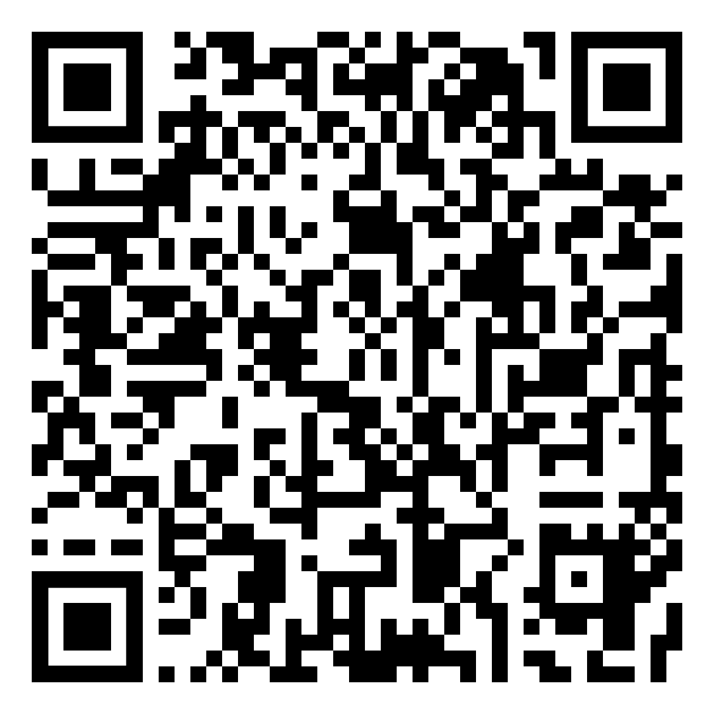
THANKS FOR
LISTENING
get the presentation
Halil İbrahim KALKAN
Co-founder & Lead Architect at Volosoft
hibrahimkalkan
hikalkan

